Slide 1
Analysis of D3-Induced Artifacts
Binary and ternary compound screening across d-block and s-block elements - 1,574 total dip rows analyzed across 52 binary and 168 ternary chemical systems.
CYT 102: Computational Chemistry
Prof. Swastika Banerjee
Harsh Gupta 23321015
3rd year BSMS Chemical Sciences
Department of Chemistry
IIT Roorkee

Slide 2

Dataset at a Glance
1,574
220
Total Dip Rows
Unique Chemsys
744 binary + 830 ternary
52 binary, 168 ternary
2
2
Blocks Detected
Ligand Types
d-block and s-block
Oxide (O) and sulfide (S)
Binary - ΔE Summary
Ternary - ΔE Summary
Range: −1.617 to −0.011 eV/atom
Mean: −0.174 | Median: −0.108
d-block: 652 rows | s-block: 92 rows
Range: −0.766 to −0.038 eV/atom
Mean: −0.133 | Median: −0.106
d-block: 762 rows | s-block: 68 rows

Slide 3
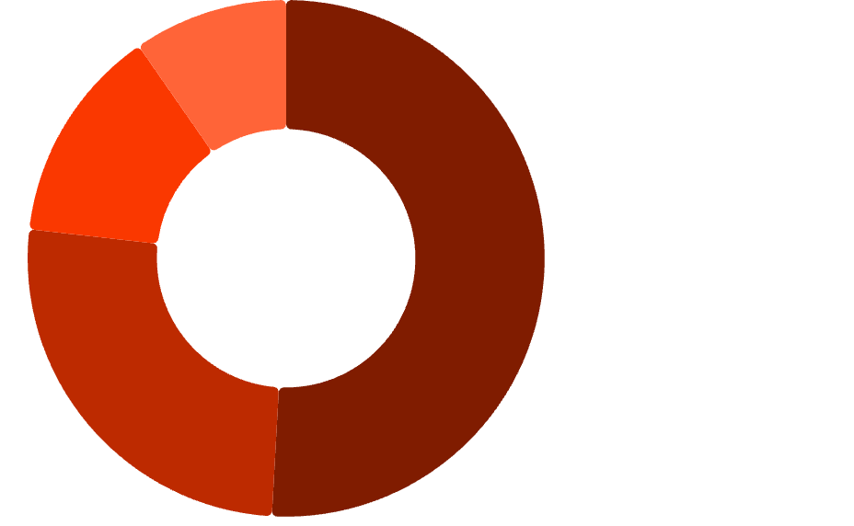
Binary Systems - Ligand & Block Distribution
Key Observations
d-block / O·50.88%
Oxide ligands dominate: 547 of 744 binary rows (73.5%) use O
d-block compounds account for 87.6% of binary entries
Sulfide systems are concentrated in d-block (197 total rows across both complexities)
All accepted entries satisfy ΔE < 0 eV/atom - no borderline cases remain
d-block / S·25.91%
s-block / O·13.55%
s-block / S·9.66%

Slide 4
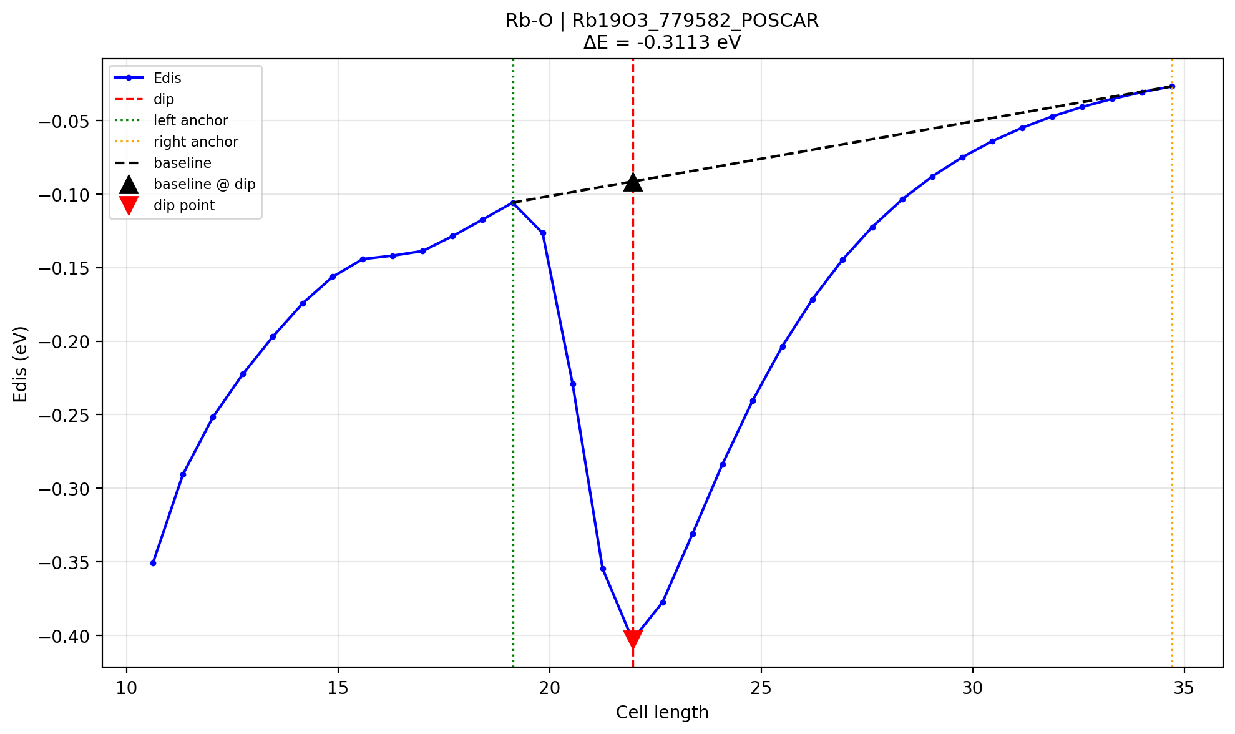
Example dip from the Plot, where the deltaE is calculated as:
Dip detection method:
local max → drop
gradient fallback
Baseline definition:
line between flanking maxima
ΔE definition:
ΔE = E_dip − E_baseline

Slide 5
Binary Top 20 - Most Negative ΔE
ΔE (eV/at.)
Chemsys
Structure
Block
Standout Systems
Mg-S leads all binary systems at −1.617 eV/atom - the global minimum across the entire dataset.
−1.6174
Mg-S
Mg149S
s
−1.6058
Ti-O
Ti3O
d
Ti-O dominates the top rankings with 9 entries in the top 20, spanning Ti3O, Ti2O, and TiO stoichiometries.
−1.6028
Ti-O
Ti3O
d
−1.5313
Ti-O
Ti3O
d
Li-O is the strongest s-block oxide system (−1.011 eV/atom), while Nb-S is the top d-block sulfide.
−1.3911
Ti-O
Ti2O
d
−1.3819
Ti-O
Ti2O
d
−1.0842
Nb-S
Nb14S5
d
−1.0108
Li-O
Li2O
s
−0.8773
Ti-O
TiO
d
−0.7231
Zr-S
Zr9S2
d

Slide 6
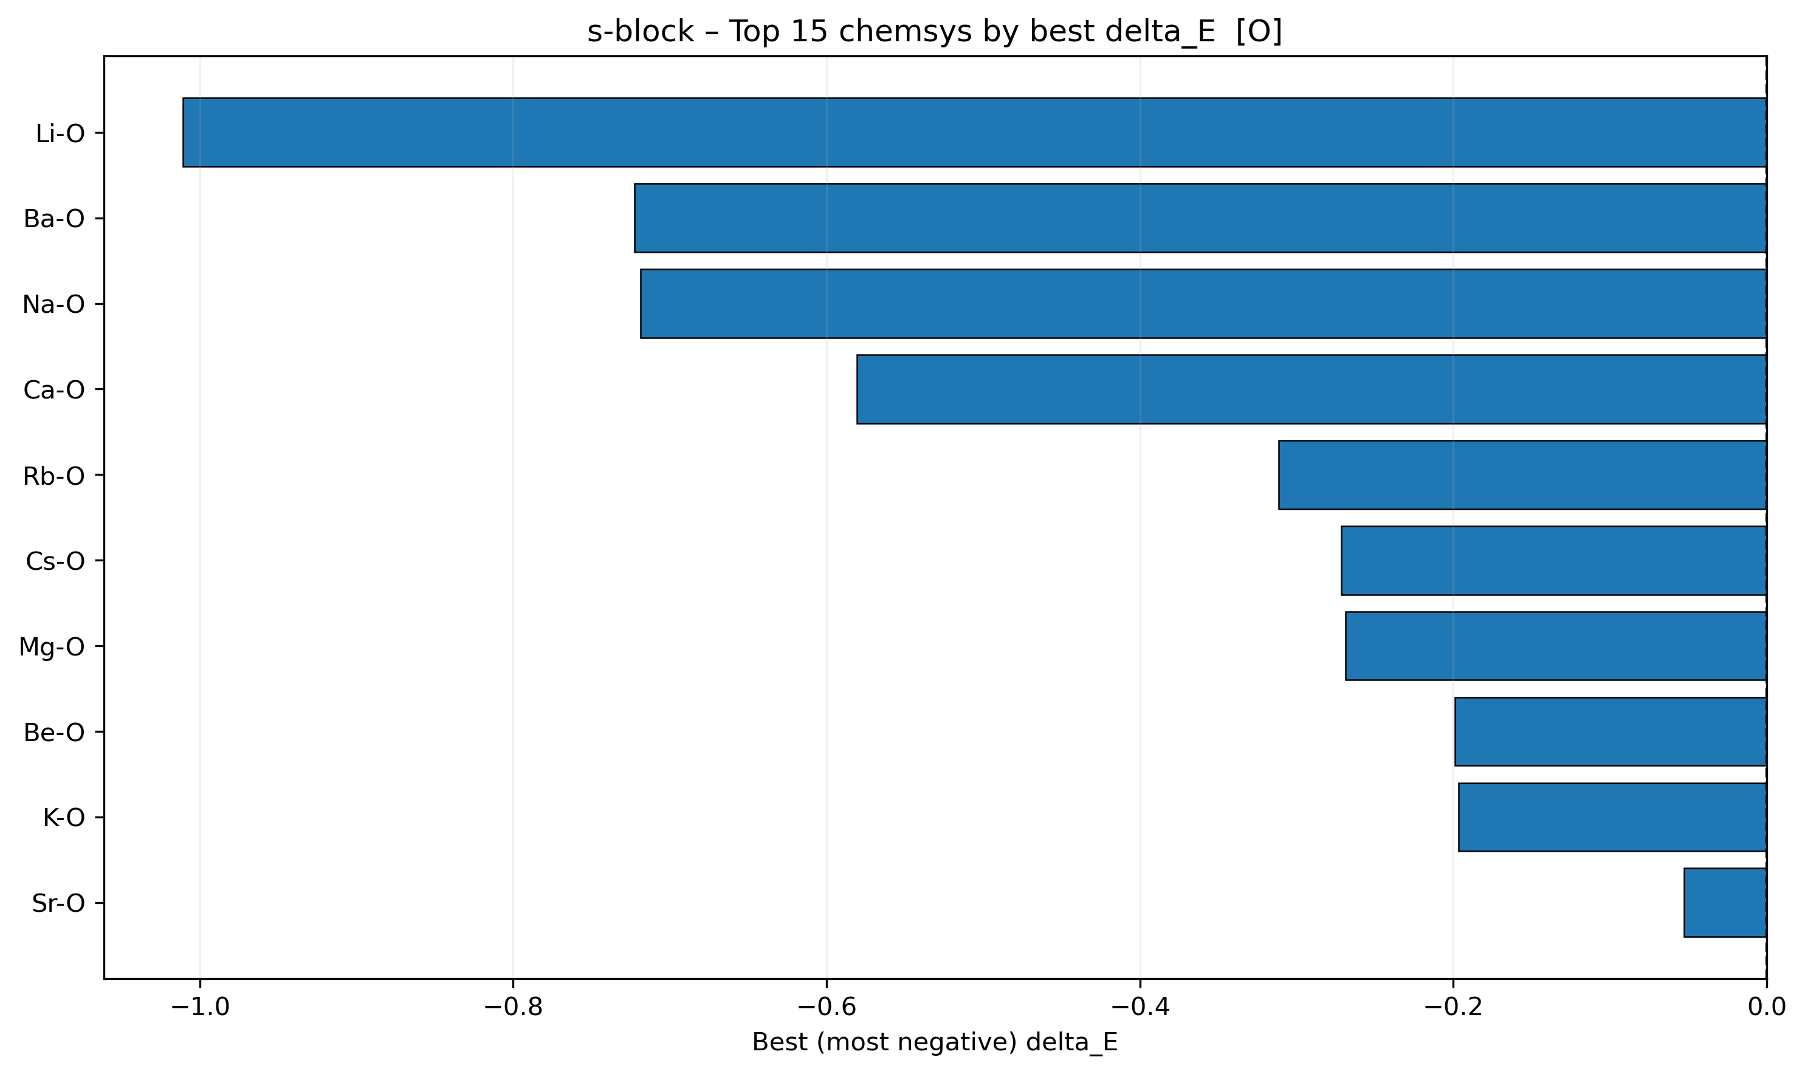
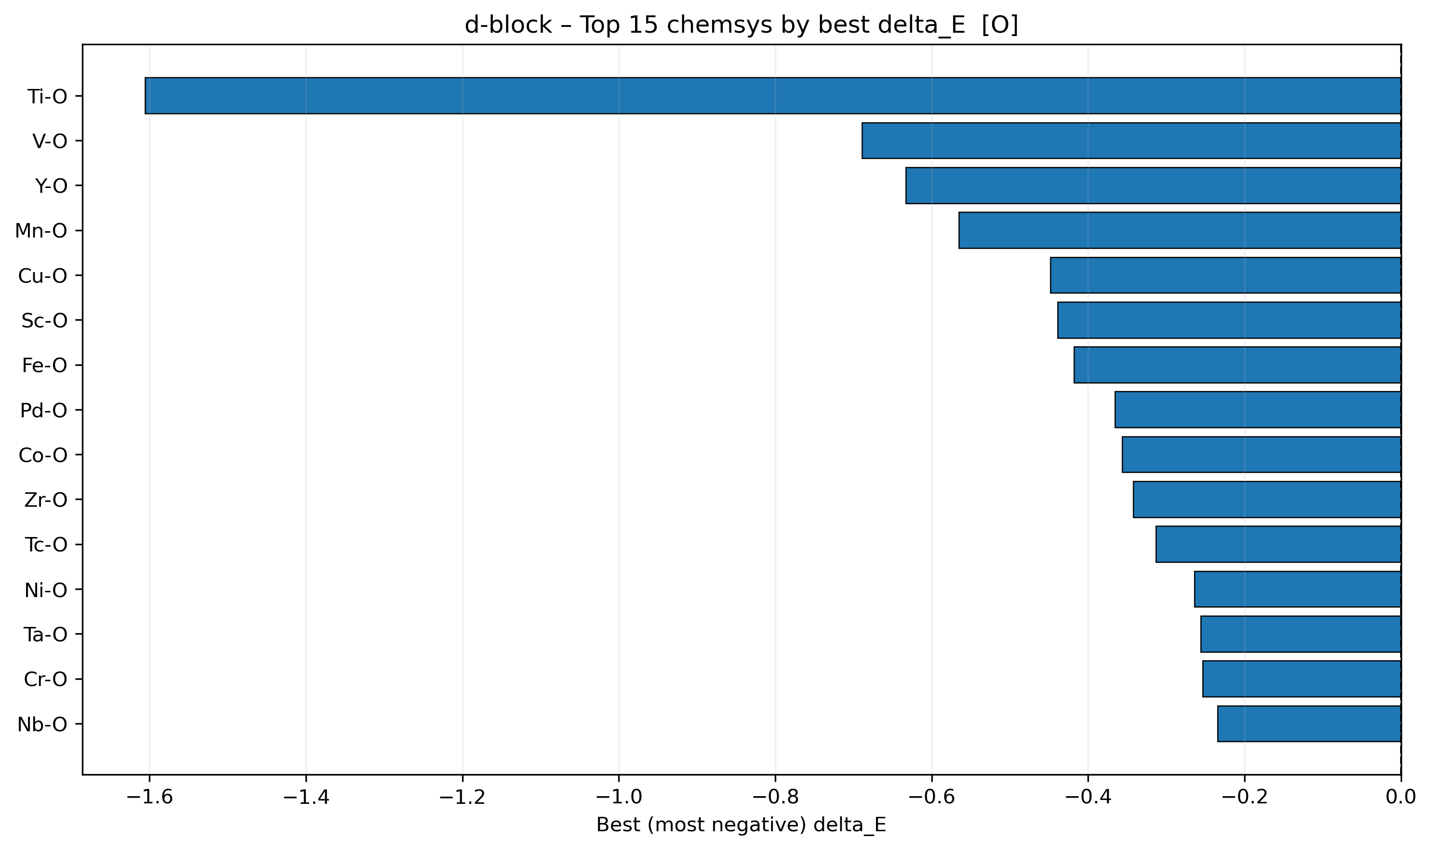
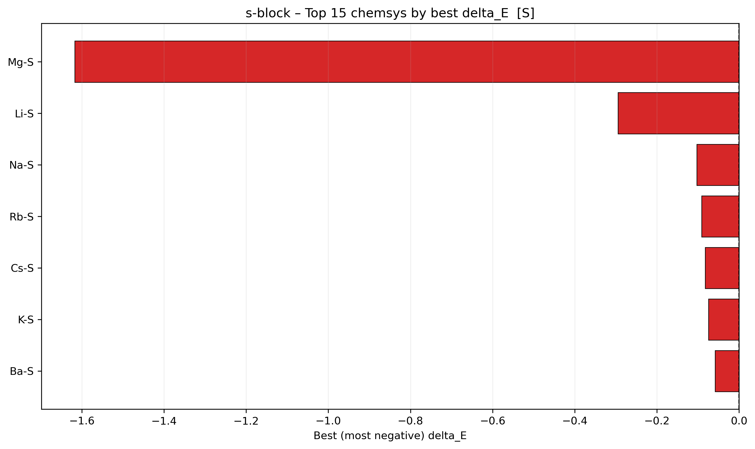
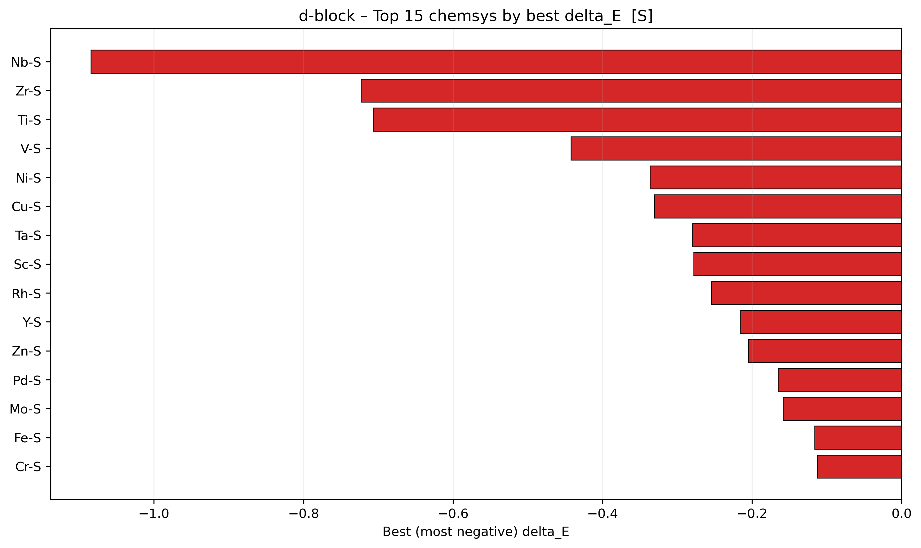
Binary comparison

Slide 7

Binary Bottom 20 - Weakest Accepted ΔE
All entries satisfy the ΔE < 0 threshold. These represent the shallowest dips still retained in the dataset - useful for identifying near-threshold artifact cases
ΔE (eV/at.)
Chemsys
Structure
Block
Marginal systems such as MgO (−0.011), V2O3 (−0.016), and Mn3O4 (~−0.030) sit just above the noise floor. These may warrant closer inspection for dataset sensitivity to the acceptance threshold.
−0.0108
Mg-O
MgO
s
−0.0132
Mg-O
MgO
s
−0.0156
V-O
V2O3
d
Notable: Cs-O, Sr-O, K-O, Na-O all appear near the boundary, suggesting weak energetic preference in heavy s-block oxide binaries.
−0.0295
Mn-O
Mn3O4
d
−0.0426
Hf-O
HfO2
d
−0.0429
Cs-O
Cs7O
s
−0.0529
Sr-O
SrO2
s
−0.0541
Co-O
CoO
d

Slide 8
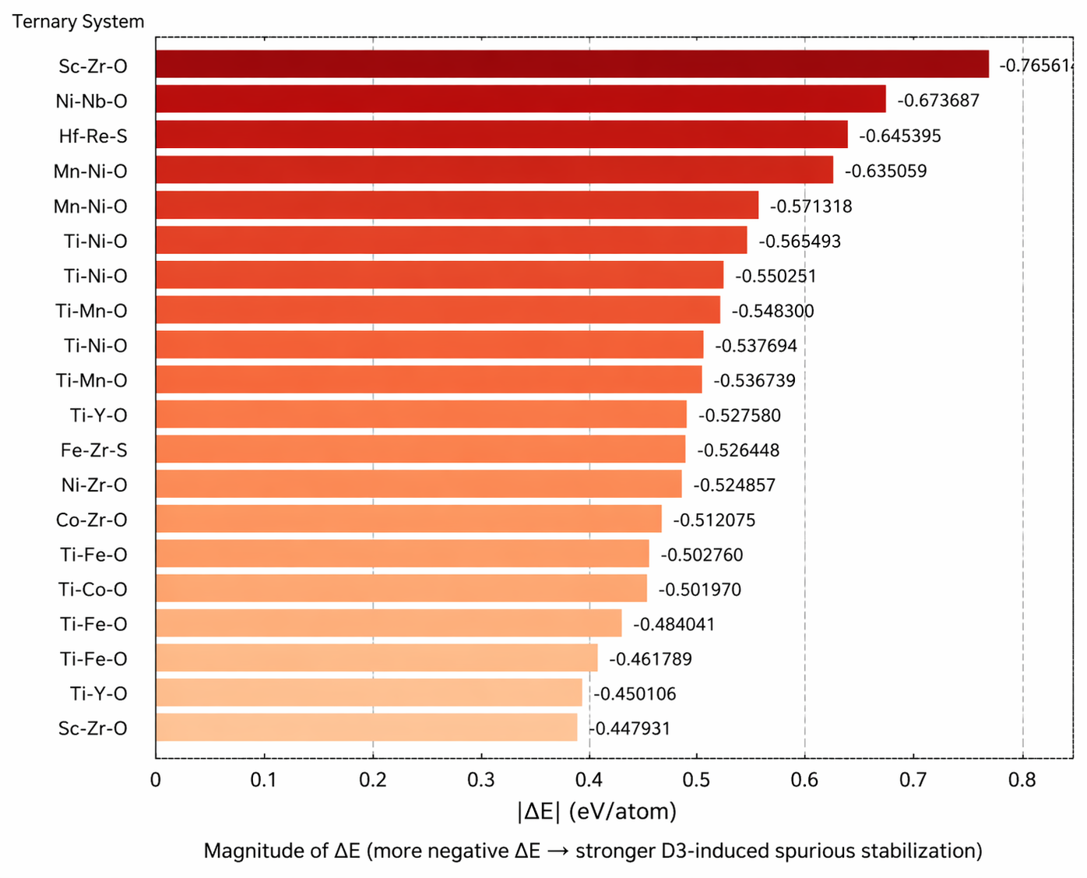
Ternary Systems - Top Metal Pairs by ΔE
Sc-Zr-O exhibits the most negative ΔE (−0.766 eV/atom; Zr25Sc6O59), indicating the strongest D3-induced spurious stabilization.
Nb-Ni-O and Hf-Re-S follow closely, with Hf-Re-S representing the most prominent sulfide system exhibiting such artifacts.
Zr-based pairs (Sc-Zr, Fe-Zr, Ni-Zr, Co-Zr) appear frequently among the most negative ΔE values, suggesting that Zr-containing systems are particularly prone to D3 over binding artifacts
Ti-based pairs (Ni-Ti, Mn-Ti, Fe-Ti, Co-Ti) dominate the mid-range ΔE regime, consistent with trends observed in binary systems.

Slide 9
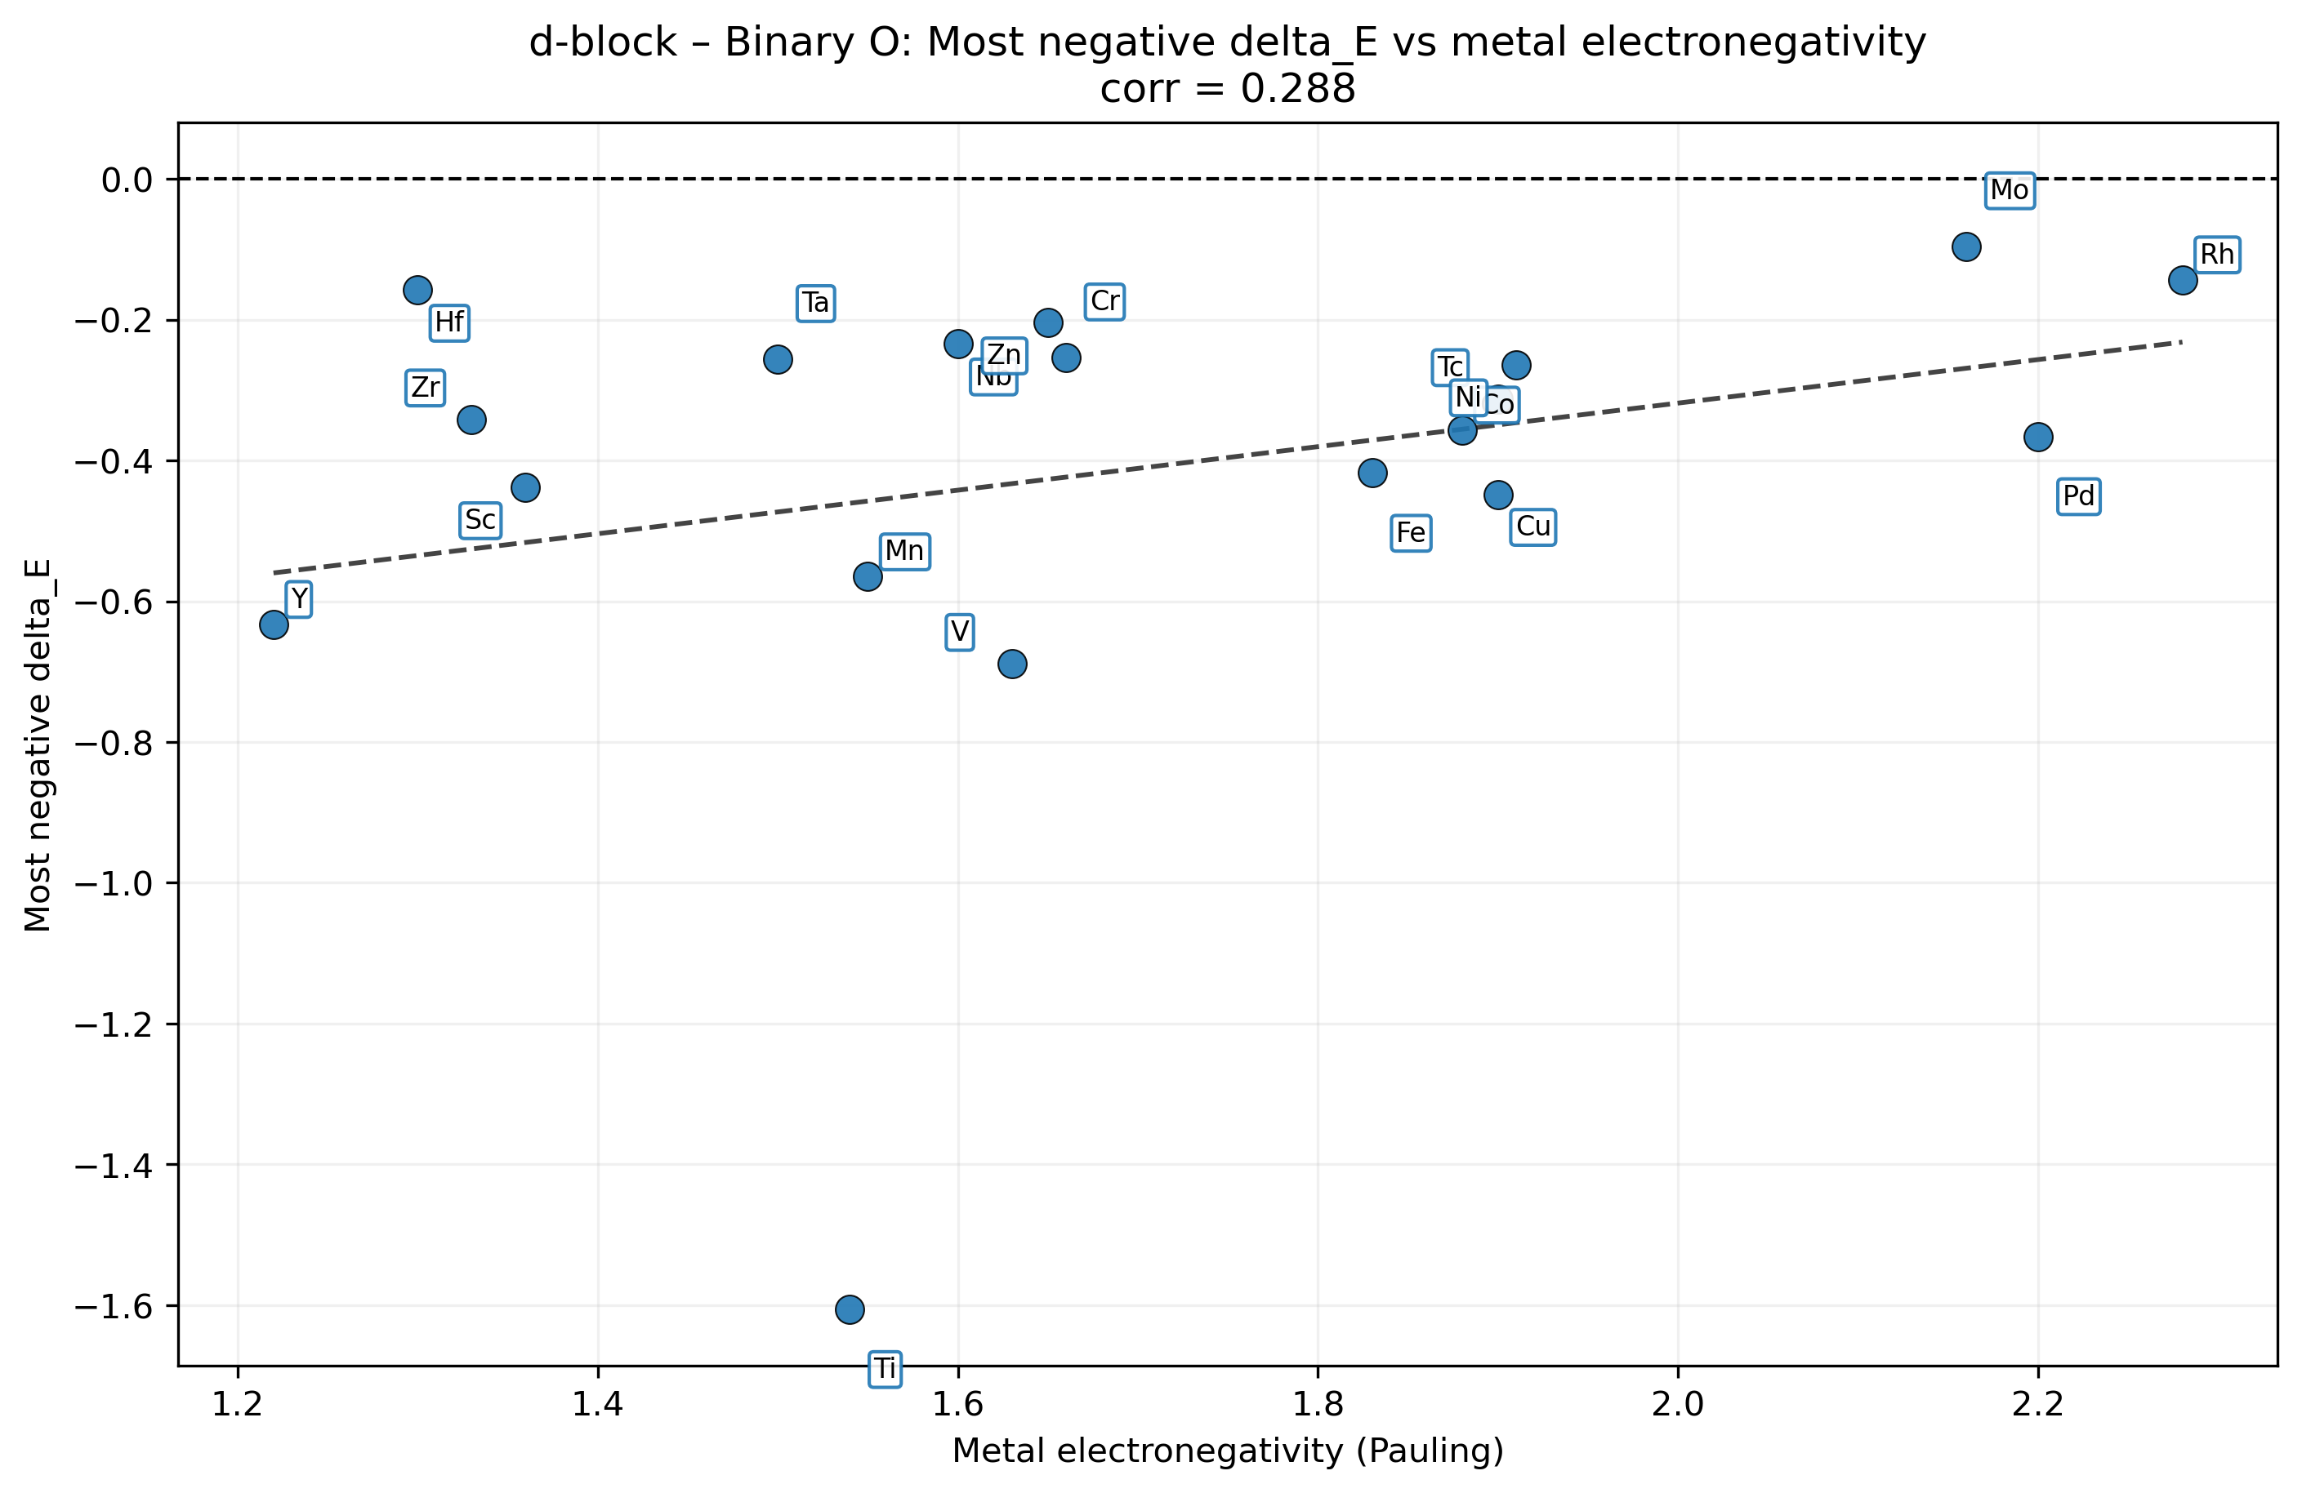
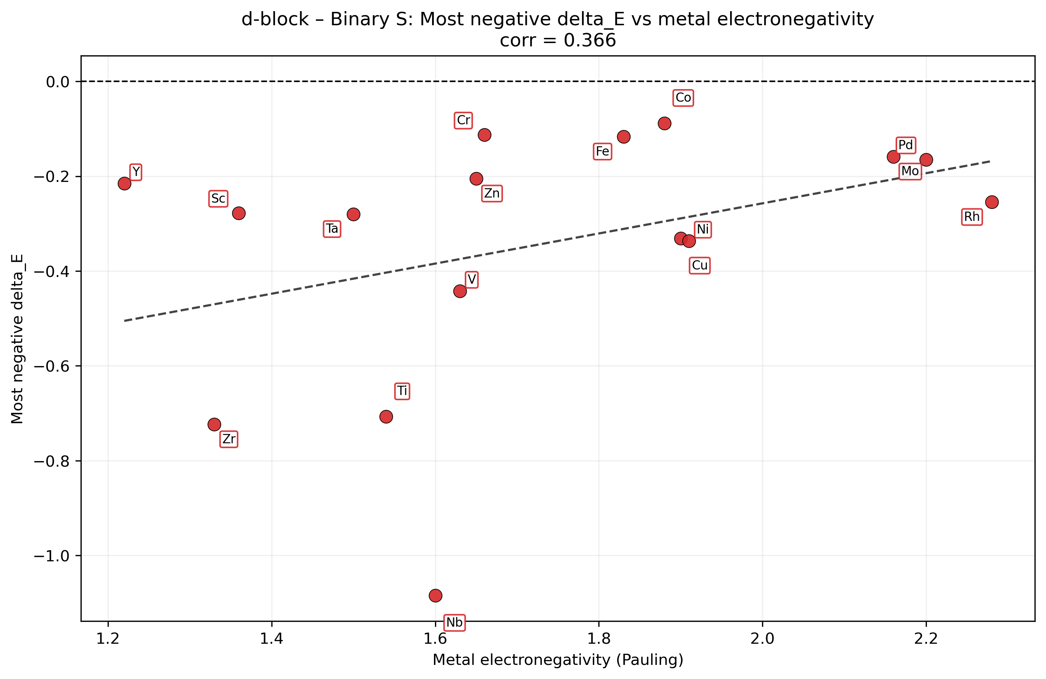
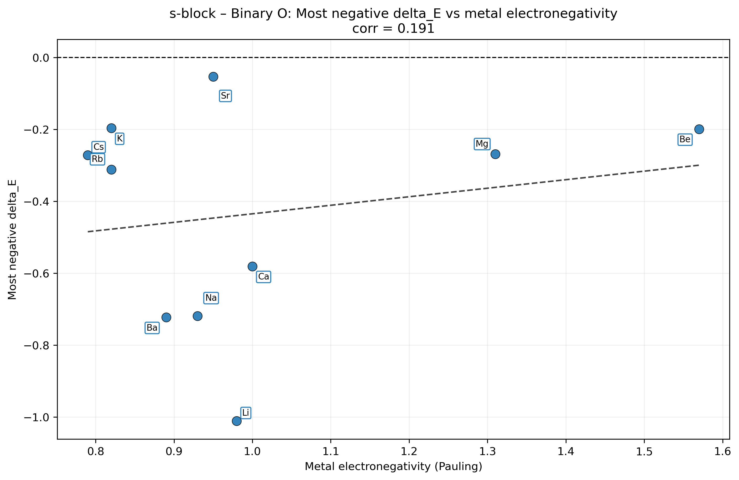
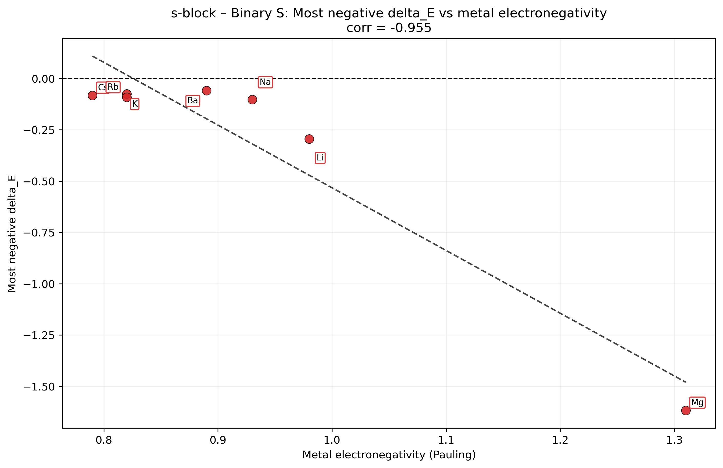
Binary compounds – Most Negative delta E vs EN

Slide 10
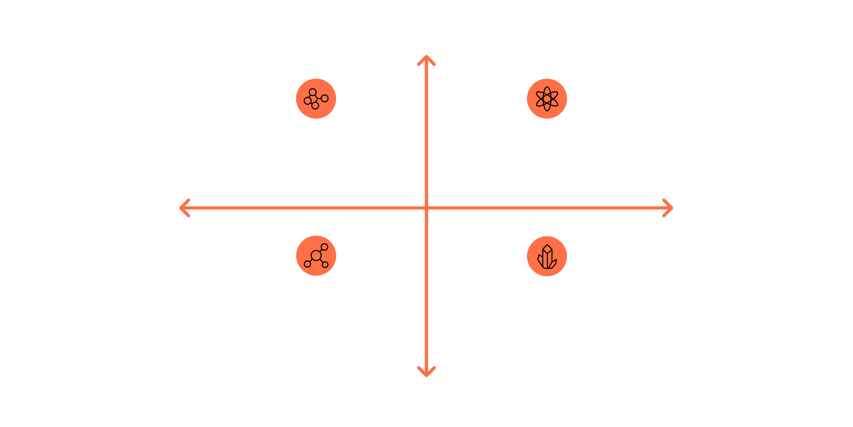
Packing Efficiency vs. ΔE - Correlation Analysis
High Packing Fraction
d-block ternary: corr −0.44
s-block ternary: corr +0.04
Lower ΔE (stronger D3-induced artifact)
Higher ΔE (weaker artifact)
s-block binary: corr +0.05
d-block binary: corr −0.41
Low Packing Fraction
d-block systems show a consistent moderate negative correlation (r ≈ −0.41 to −0.44) between packing fraction and ΔE, indicating that denser packing enhances D3-induced spurious stabilization. s-block systems show near-zero correlation, suggesting packing geometry is not a primary driver of this artifact in these compounds.

Slide 11
Within-Chemsys Correlation Extremes
(corr(packing_fraction, ΔE))
d-block Binary
d-block Ternary
Most negative: Pd-O r = −1.000
Most negative: Mo-Hf-S r = −1.000
Most positive: Co-S r = +1.000
Most positive: Hf-Re-S r = +1.000
31 of 35 chemsys with within-corr computed
88 of 138 chemsys with within-corr computed
s-block Binary
s-block Ternary
Most negative: Cs-S r = −1.000
Most negative: Li-Ba-O r = −1.000
Most positive: Li-S r = +0.9996
Most positive: Rb-Cs-O r = +1.000
15 of 17 chemsys with within-corr computed
19 of 30 chemsys with within-corr computed
Most negative correlation (packing ↑ → stronger D3 artifact)
Most positive correlation (packing ↑ → weaker D3 artifact)

Slide 12
Grouped ΔE Statistics - Block × Ligand
Binary Systems
Ternary Systems
Group
Cats.
Most Neg
ΔE
Mean of most min ΔE
Ligand
Group
Cats.
Most Neg
ΔE
Mean of most min ΔE
Ligand
d-block
19
−1.606 [Ti]
−0.410
O
d-block
95
−0.766 [Sc-Zr]
−0.220
O
d-block
16
−1.084 [Nb]
−0.344
S
d-block
43
−0.645 [Hf-Re]
−0.173
S
s-block
10
−1.011 [Li]
−0.433
O
s-block
26
−0.378 [Ba-Na]
−0.148
O
s-block
7
−1.617 [Mg]
−0.332
S
s-block
4
−0.101 [K-Na]
−0.079
S
s-block ternary sulfides form the smallest subset (4 categories) and exhibit the narrowest ΔE range (−0.057 to −0.101), indicating weak and relatively uniform D3-induced artifacts across these systems.

Slide 13
Key Findings & Takeaways
Mg-S & Ti-O Show the Strongest D3 Artifacts
Mg149S (−1.617 eV/atom) and multiple Ti-O polymorphs exhibit the most pronounced D3-induced spurious stabilization. Ti-O alone contributes 9 of the top 20 binary artifact cases.
Sc-Zr-O Shows the Strongest Ternary D3 Artifact
Zr25Sc6O59 (−0.766 eV/atom) exhibits the largest D3-induced artifact among ternary systems. Zr-containing pairs (Sc-Zr, Ni-Zr, Co-Zr, Fe-Zr) frequently appear among the most error-prone systems, indicating a strong susceptibility to D3 overbinding.
Packing–Artifact Correlation Exists for d-block Only
d-block systems show r ≈ -0.41 to -0.44, indicating that higher packing fraction correlates with stronger D3-induced artifacts. s-block systems show near-zero correlation (r ≈ +0.05), suggesting packing is not a key driver of this error.
Oxides Dominate, Sulfides Show Strong Artifact Cases
Oxides account for 73-89% of systems by ligand. However, several sulfide systems (Mg-S, Nb14S5, Hf-Re-S) exhibit some of the largest D3-induced artifacts, highlighting the need for targeted sulfide analysis.

